Slide 1
Architecture and Complex Software Solutions
Notes:
By no means does software succeed without making some architectural decisions. Sometimes they're easy, almost implicit, but sometimes there are not. It's in those situations where architecture isn't implicit and in need of very serious consideration. This session will contrast Design and Architecture and dig into some areas where the needs that architecture can address are not so easily addressed by File/New/Project. The session will continue with why those areas require unique attention as well as how Architecture addresses them.

Slide 2
Agenda
Design v Architecture
Why Architect?
Decisions
Details of Architecture
Communicating the architecture
Best practices
Q&A and Feedback

Slide 3
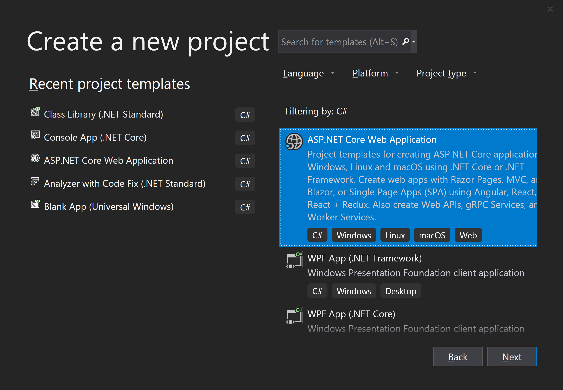
When template architecture is not enough

Slide 4
Fundamentals of Design

Slide 5
Importance of Design

Slide 6
Fundamentals of Architecture
Specifically addresses:
High-level design

Slide 7
Importance of architecture

Slide 8
Design v Architecture

Slide 9
Purpose of Architecture
Quality Attributes (sometimes called Non-Functional Requirements)
Decisions that effect
Composition
Innovation is inherently about experimentation and validation
Architecture should systemize that experimentation, providing a foundation for software based on proven facts

Slide 10
A Continuum of Decisions
A
B
C
D
E
F

Slide 11
A Continuum of Decisions
A
B
C
D
E
F

Slide 12
A Continuum of Decisions
A
B
C
D
Notes:
Empirical process TODO: find more on empirical process/contrast

Slide 13
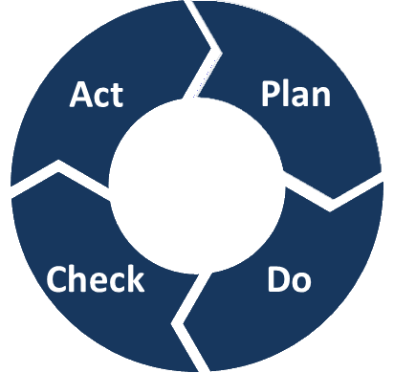
Familiar Cycle

Slide 14
Deming Cycle
or Shewhart Cycle
Adjust
An Observation Starts the Cycle
Study

Slide 15
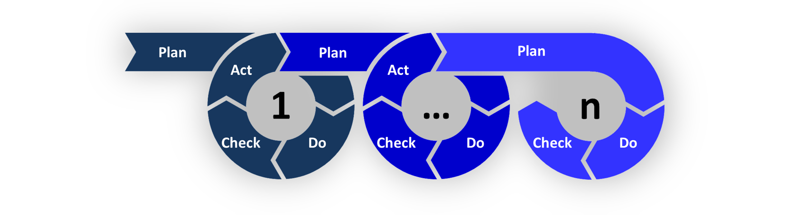
Chained Cycles

Slide 16
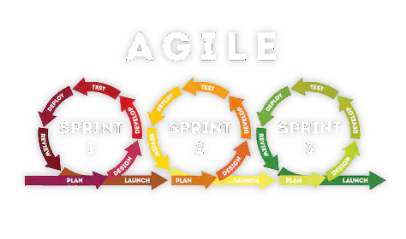
Familiar Cycle

Slide 17

Combine for Experimentation
If measurements
suggest, plan for real
Based on mental model
The Real Thing, with
greater certainty
Progress from
“untried” to “tried”

Slide 18
PDCA
Plan
What process and activities are required?
What are the measurable objectives?
Do
Perform process and activities
Check/Study/Measure
Evaluate actual, compare to expected
Act/Adjust
Where were objectives not met, what could be changed to reach those objectives?

Slide 19
Higher-Level Decisions, Separate From Lower
Architected on purpose, rather than by accident
By Design™
Critical Thinking
System Thinking
Rationale
Design Rules, constraints
Etc.

Slide 20
Conceptual Integrity

Slide 21

Conceptuality of Architecture
Not one thing
Concepts and ideas
On paper
On whiteboards
In Minds
Evolves over time

Slide 22
Supports Many Phases
Technology decisions
Recording technology usage

Slide 23
Parts of an Architecture
Additions
Modifications
Removals
Concepts (boxes)
Relationships (lines)

Slide 24
Model-Driven Architecture (MDA)
Concepts
Conceptual models
Exploration, thought experiments
Progress from abstract to less abstract
Breadth without overwhelming detail
Supports iterative processes

Slide 25
Concepts Within the Model
Components
Connectors
Component Entity (component abstraction)
Interface
Ports
Synchronous Connections
Asynchronous Connections
Composition model

Slide 26
Composition Model
Very important part of an architecture
How the system comes together
Remote/distributed composition
SOA
Event-driven messaging
Etc.
High-level component compositions
Usually side-effect of distribution choices

Slide 27
Communicating the Architecture

Slide 28
Stakeholders
Users, owners
Budget holders
Subject matter experts
Engineers
Testers
Acceptance

Slide 29
“Views” of the Architectural Model
There is no one audience of an architecture
No single point in time the architecture is viewed
Must consider the different audiences
Must consider the different phases supported
Must consider the evolving knowledge and detail

Slide 30
Four+ Views
Logical View
Development View
Process View
Physical View
Scenarios

Slide 31
Logical
Functionality, what users will use
Used in early stages to align stakeholders, to agree to proceed
Might be “need”, might be “require”
Very conceptual, focused on domain
Entities
Processes, Activities/Tasks
Rules

Slide 32
Logical
Techniques that may come into play
Functional Decomposition
Business Process Modeling (BPMN)
Decision Modeling (DMN)
Too early for
Data flow
Technology
Containers

Slide 33
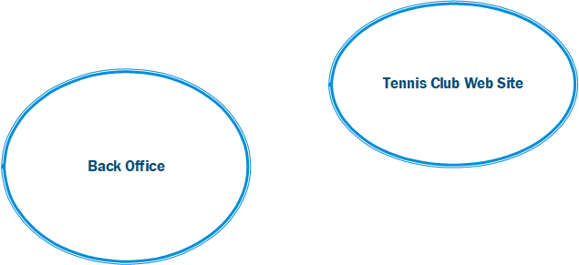

Slide 34
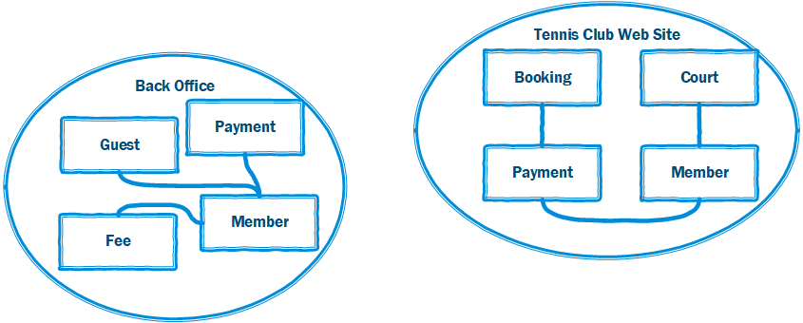

Slide 35
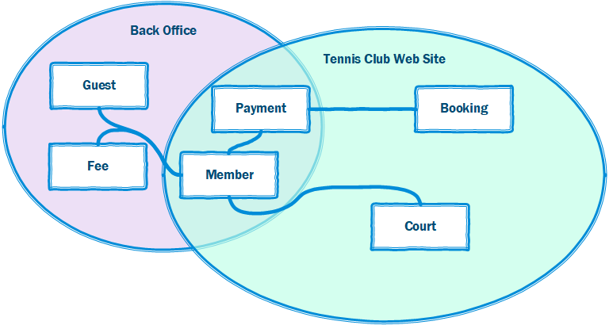

Slide 36
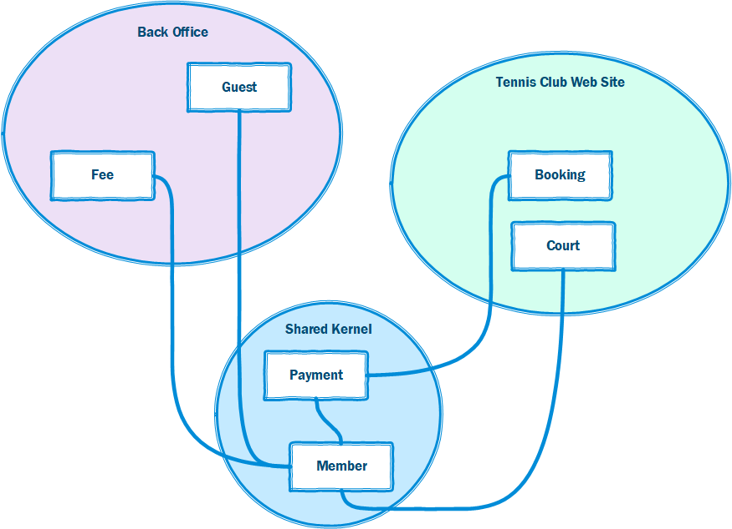

Slide 38
Process
Looking into quality attributes
E.g. Performance, Availability
Making decisions involving
Concurrency, Distribution
Integrity, fault tolerance
How logical pieces fit with Process Architecture
Still conceptual, but getting more architectural
Audience: Senior engineers, security, system engineers

Slide 39
Process
Concepts that may come into play
Multi-threading
Networking
Upstream/downstream
Grouping by domain tasks and execution (containers)
Too early for
Technology beyond communications
Module organization, subsystems
Engineer/developer allocation

Slide 40
Development
Laying out decisions involving
Most technology
Logical grouping by abstraction/commonality level
Subsystem partitioning
Execution environment
Module partitioning
Audience: engineers, developers

Slide 41
Development
Methodologies that may come into play
Object-oriented, functional
Layering
Concepts
Modules, containers, classes
Technology
Separation of responsibilities

Slide 42
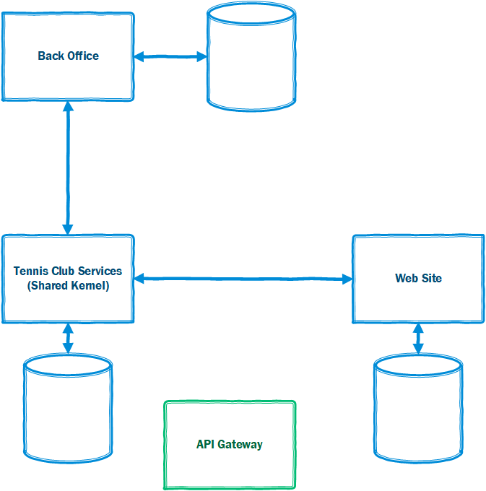

Slide 43
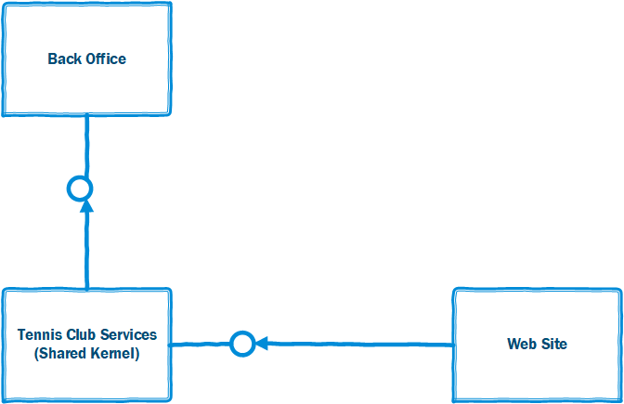

Slide 44
Physical
Physically independent pieces
Adherence to existing infrastructure or
Detail of infrastructural requirements (deltas)
Connection points
Deployment dependency directions
Information flow directions

Slide 45
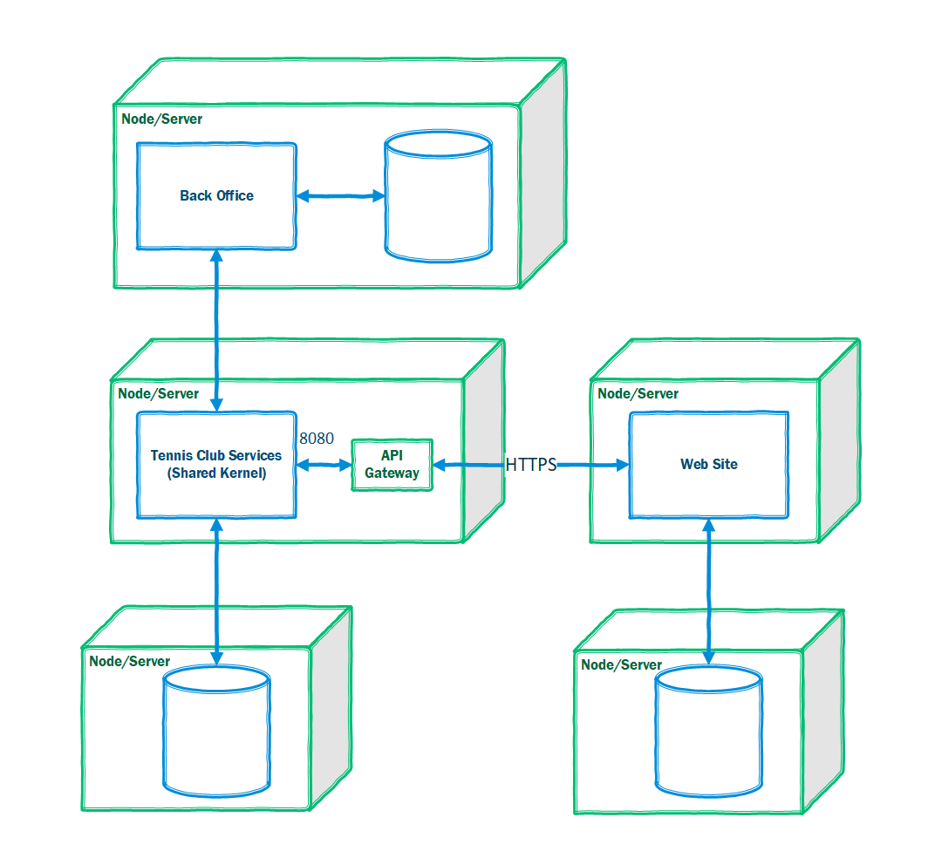

Slide 46
Scenarios
Important scenarios, more general use cases
Scenarios for each view, then overlapping
Interaction between concept (entities, objects, process, nodes)
Scenario diagrams, object interaction diagrams, etc.
Usually very logical, might involve technology scenarios for novel usages

Slide 47
Influence Between Views
Notes:
Arrows represent how, and to what degree, decisions in one effect others

Slide 48
Lineage of Views
Scenarios
Logical
Physical
Development
Process
Notes:
Arrows represent how, and to what degree, decisions in one effect others

Slide 49
Style v Pattern
Architectural Pattern
Architectural Style

Slide 50
Practices

Slide 51
Avoid Architectural Anachronisms

Slide 52
Patterns

Slide 53
Architecture Has Borders But Not an Island
Includes rationale
Traceability to needs, constraints, rules, etc.
Based from high-level principles and guidelines
Lower-level principles of guidelines
Describes the conceptual integrity, what it means for the system to be correct.

Slide 54
Review
Complexity reduction
Logical partitioning based on independent concepts

Slide 55
Gall’s Law (1975)
A complex system that works is invariably found to have evolved from a simple system that worked. A complex system designed from scratch never works and cannot be patched up to make it work. You have to start over, beginning with a working simple system.

Slide 56
Lehman’s Law (1974)
As a system evolves, its complexity increases unless work is done to maintain or reduce it.

Slide 57
References
https://medium.com/@jamieschwandt/the-critical-thinkers-ooda-loop-6a69e878c153

